Slide 1
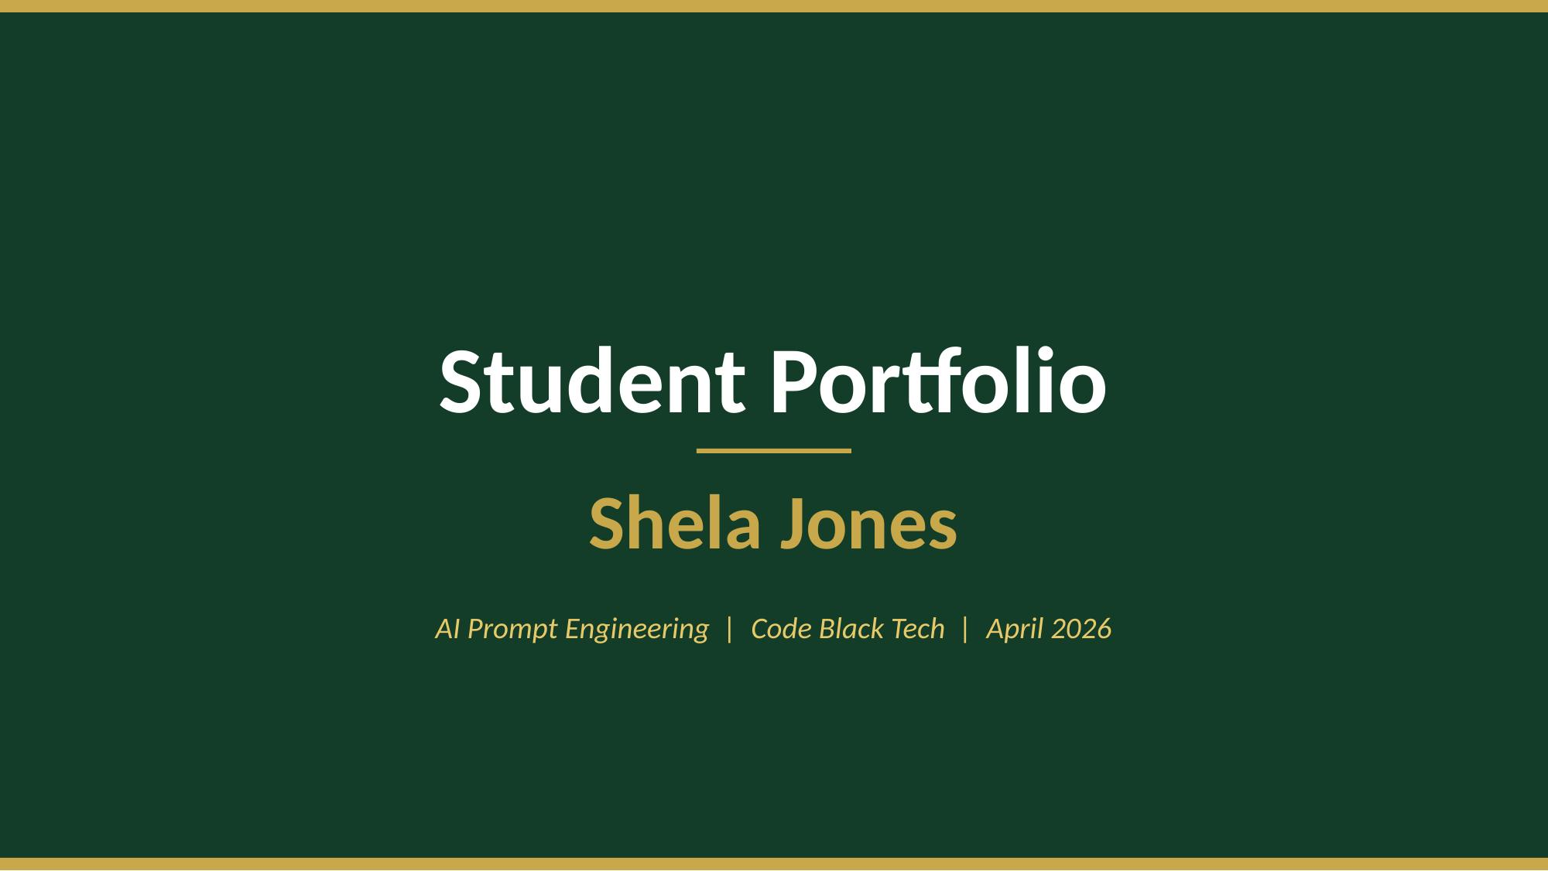

Slide 2
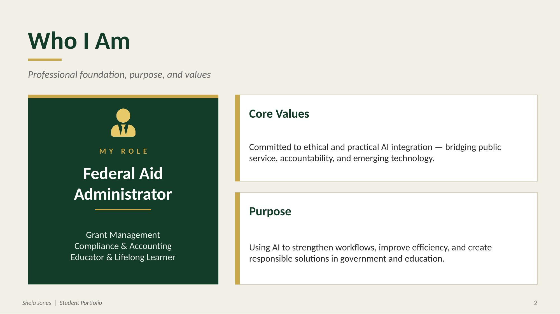

Slide 3
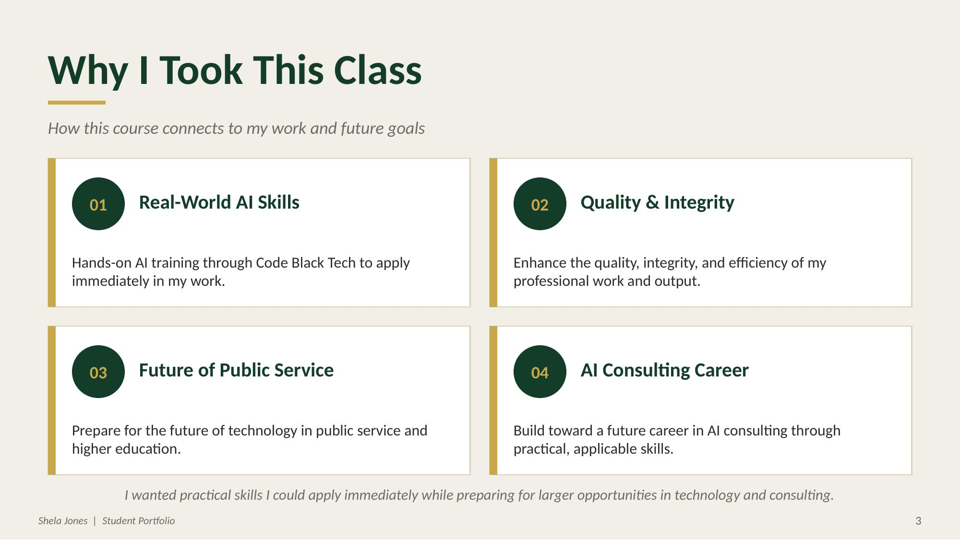

Slide 4
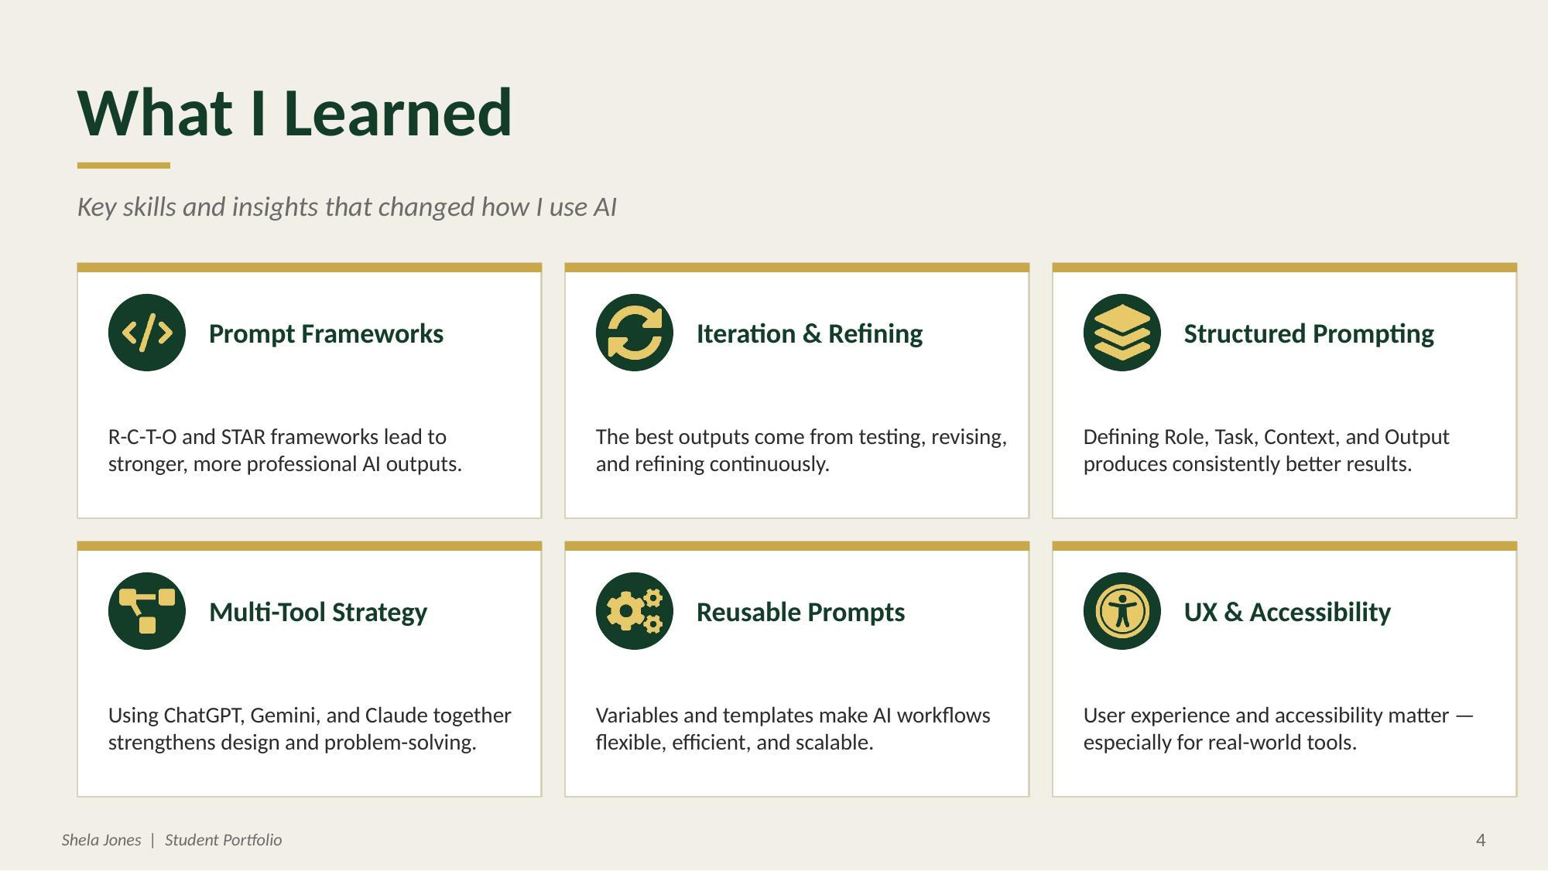

Slide 5
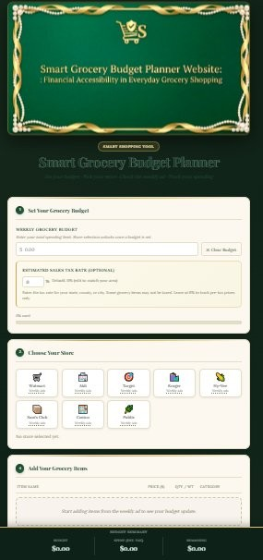
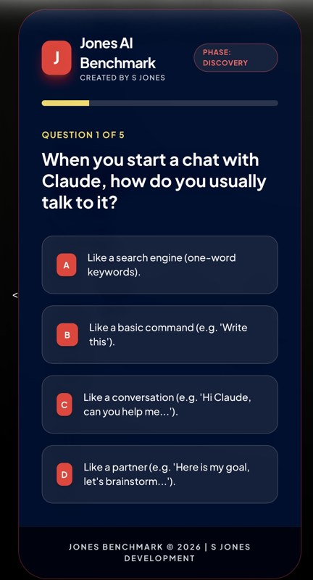
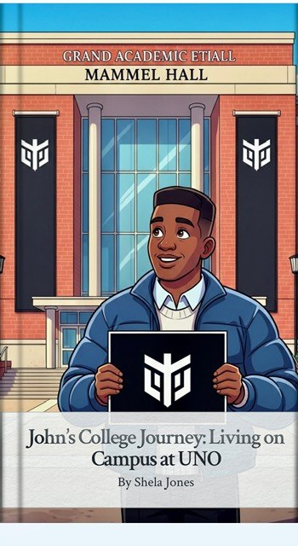
My Best Work
Projects that reflect my creativity, growth, and applied skills
01
02
03
CAPSTONE
EVALUATION TOOL
CREATIVE PROMPTING
Smart Grocery Budget Planner
Jones's AI Benchmark
John's College Journey
ChatGPT — Structure & Logic
Gemini
Gemini
Gemini — UX & Design
Deployed with CodePen
AI-illustrated storybook
Claude — Code & Debugging
Deployed with Netlify
Shela Jones | Student Portfolio
5

Slide 6
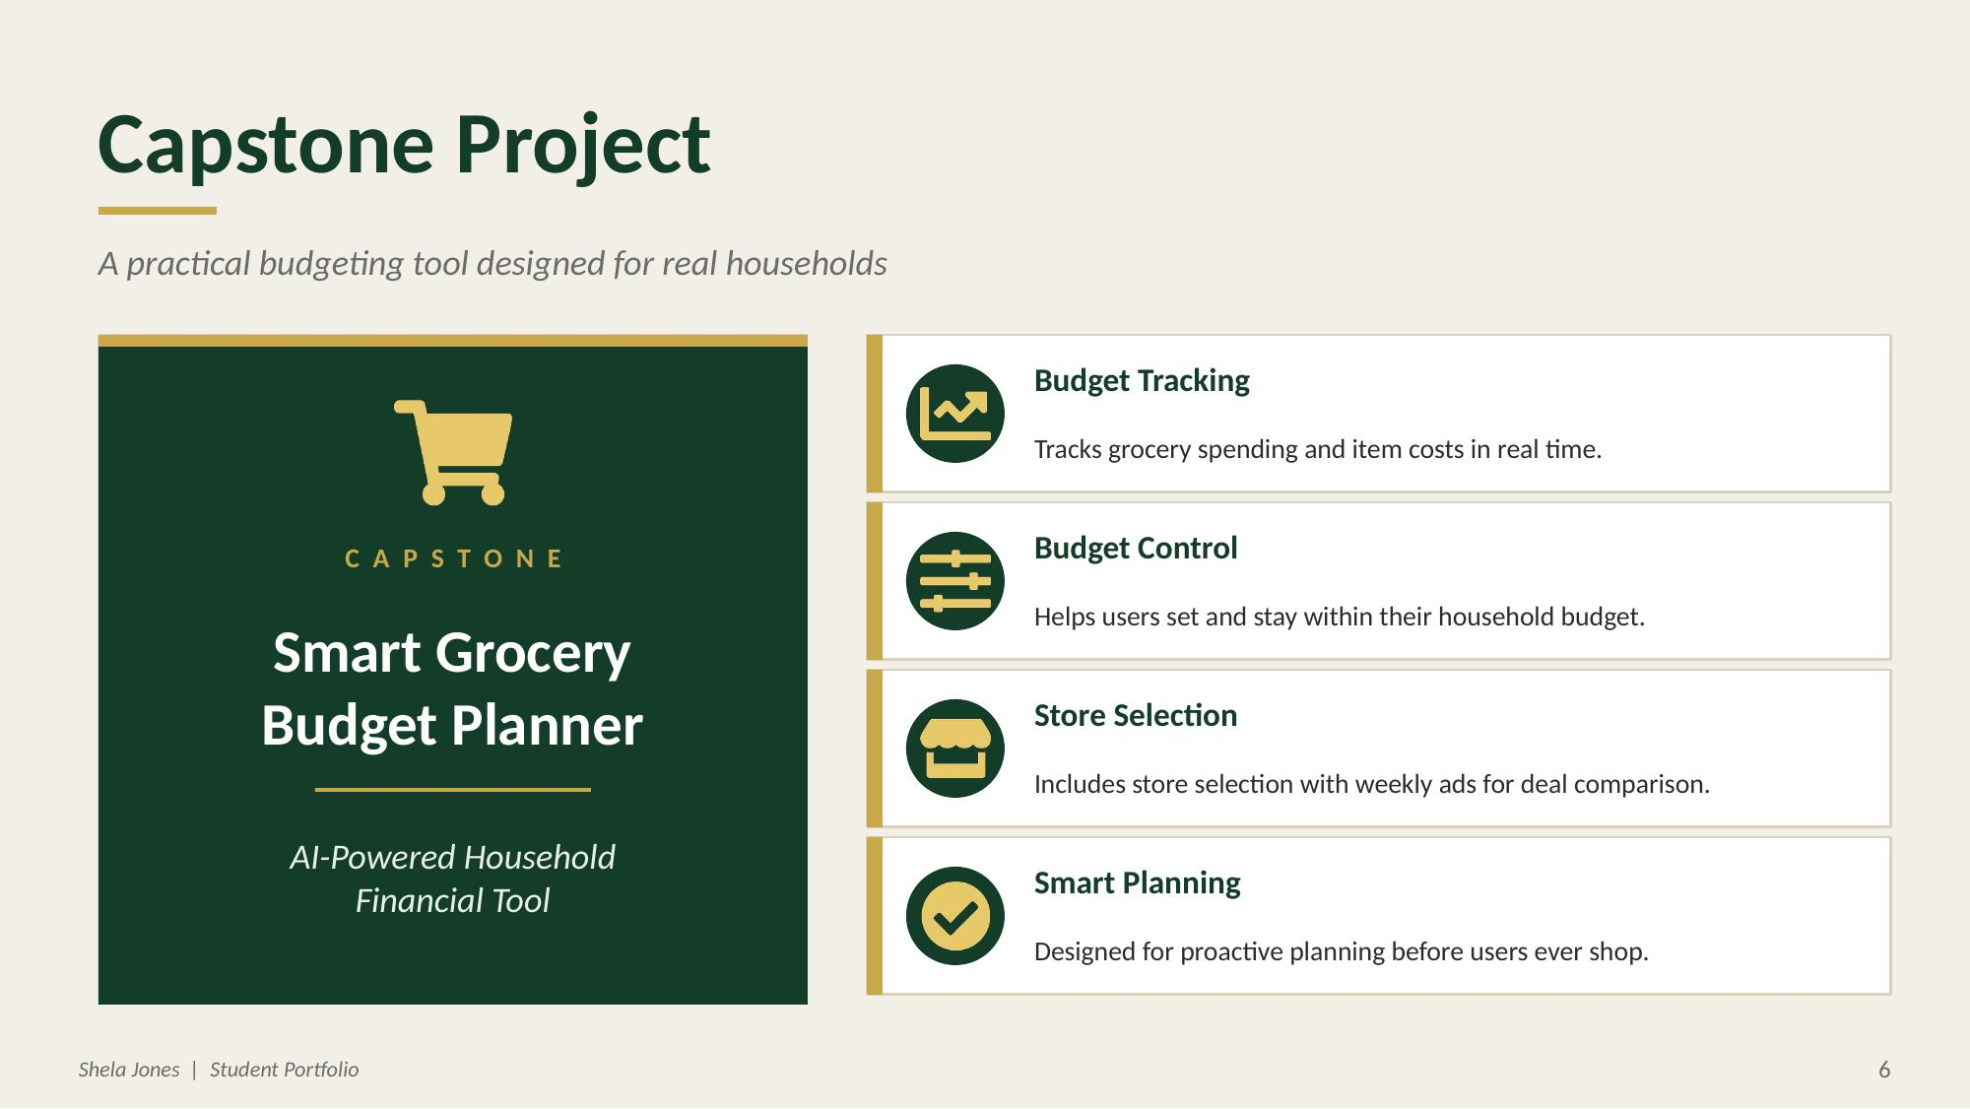

Slide 7
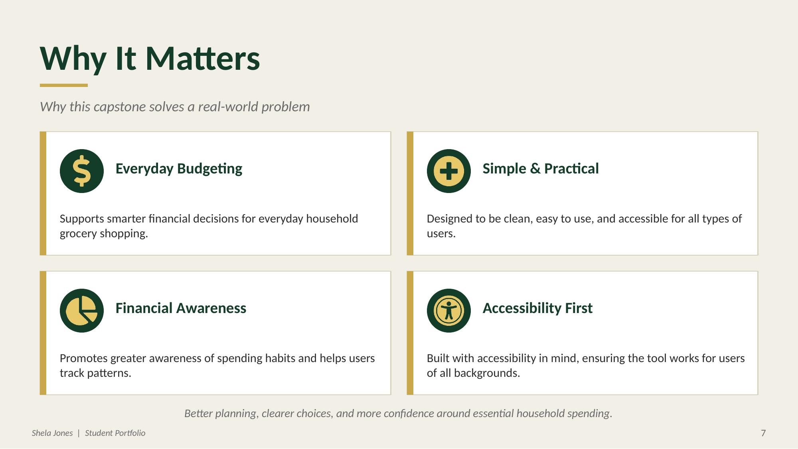

Slide 8
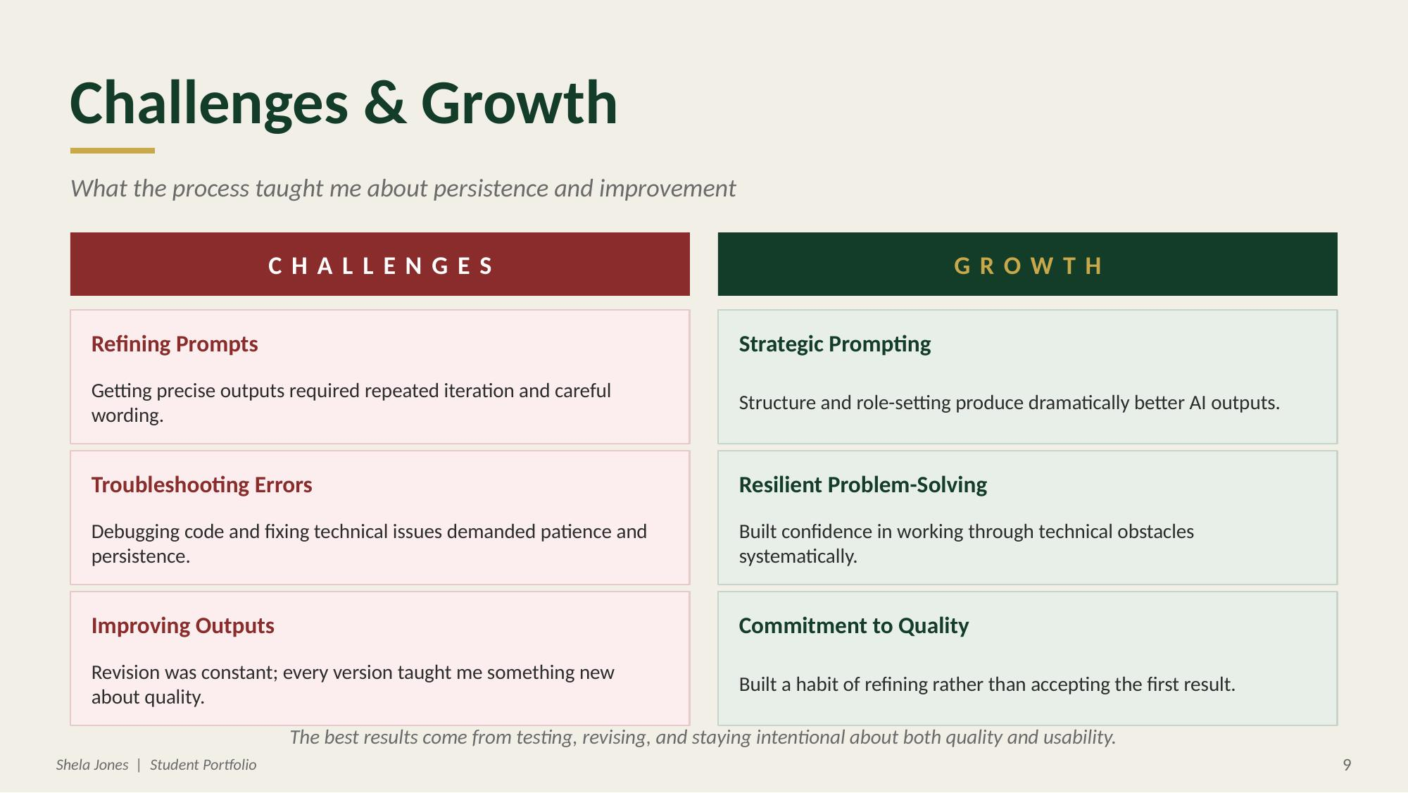

Slide 9
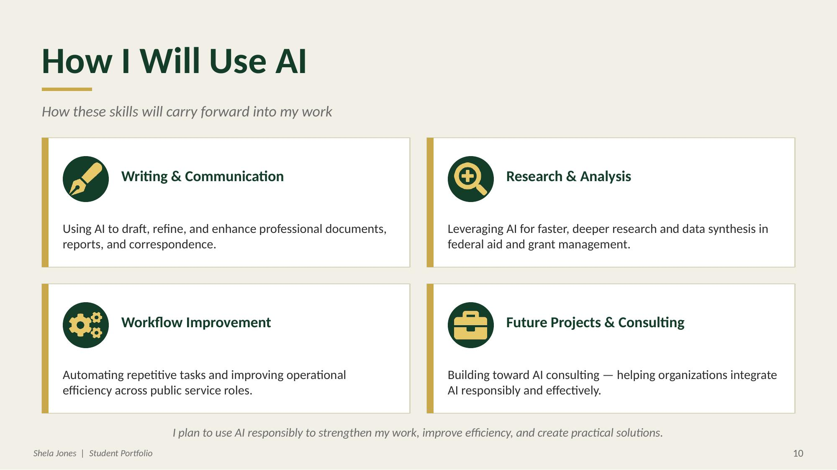

Slide 10
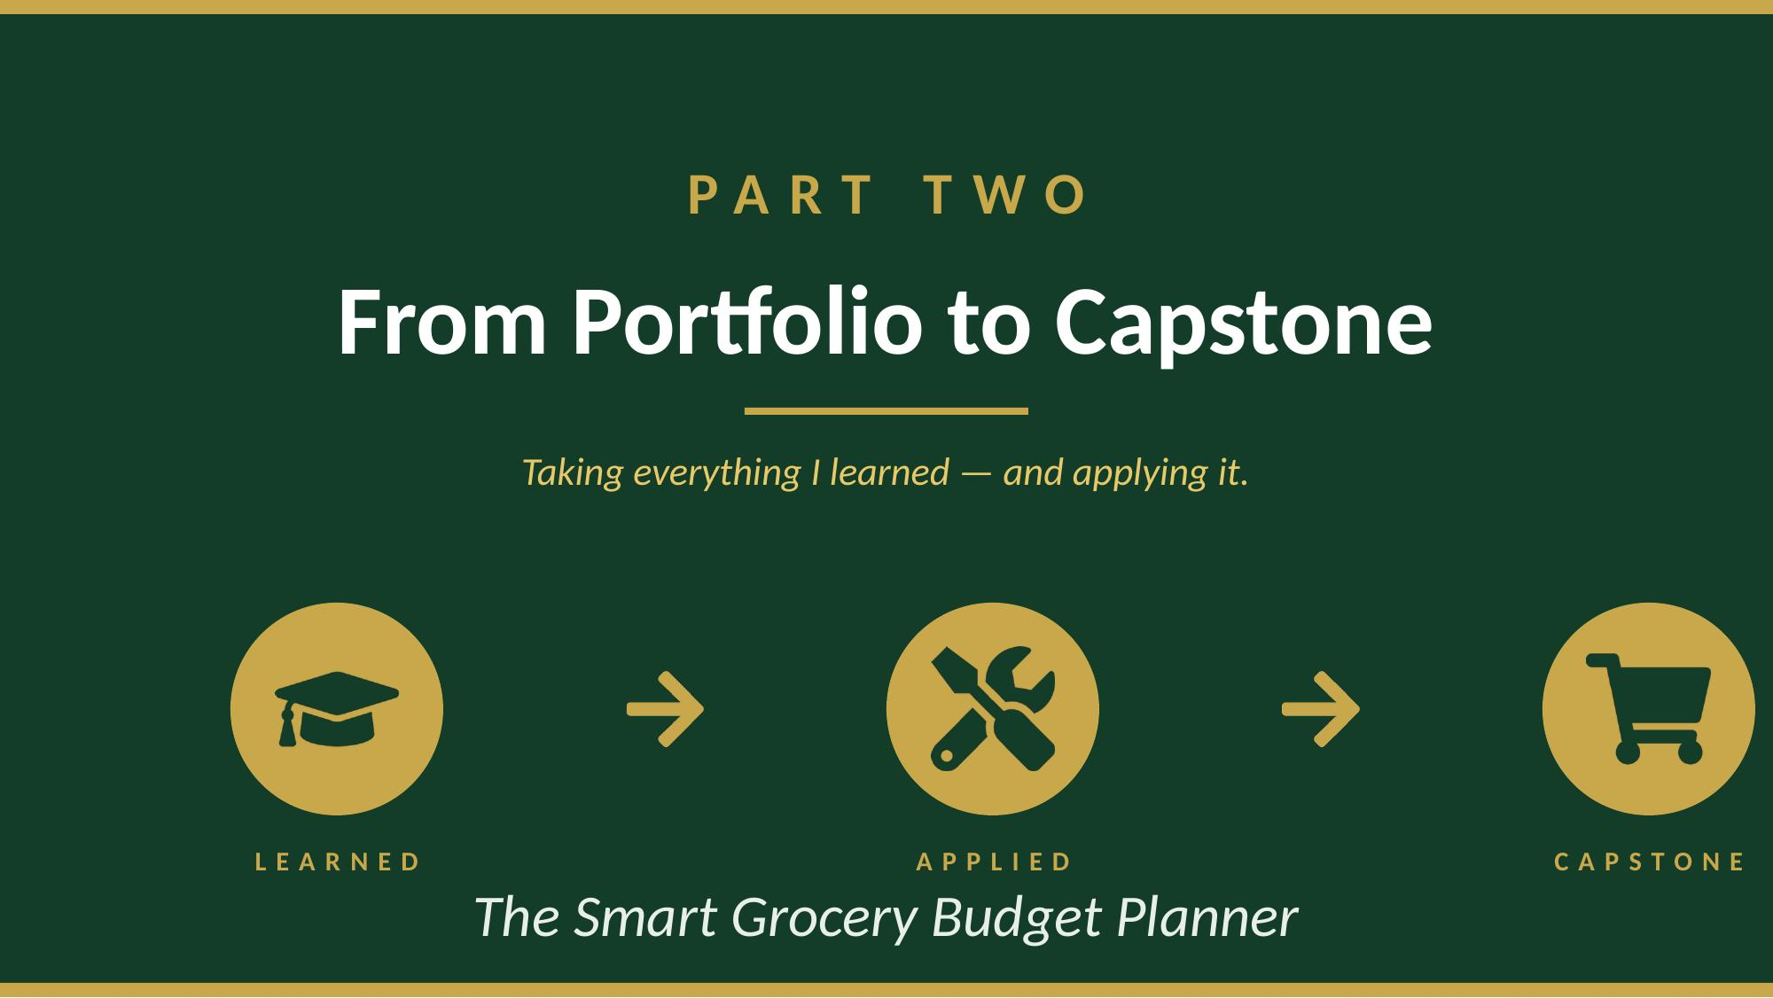

Slide 11
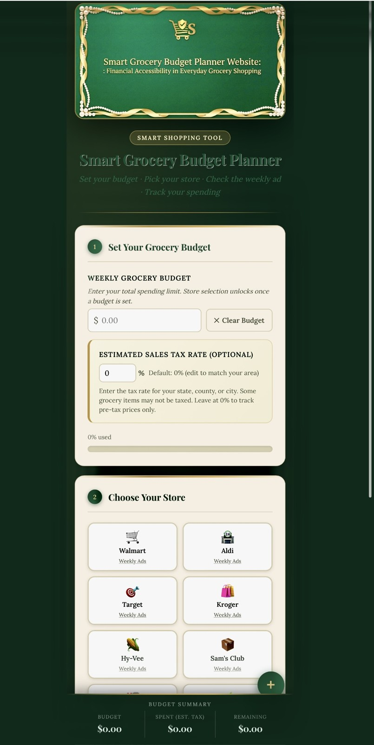





Live Website Demonstration
Smart Grocery Budget Planner — see it in action
LIVE DEMO
What you'll see:
Set a weekly budget with tax rate
Choose from 6 stores with weekly ads
Add items, track costs in real time
See budget usage and remaining funds
Copy, email, or export your list
Deployed live on Netlify
Shela Jones | Student Portfolio
12
A preview — the full tool will run live during the demo.

Slide 12
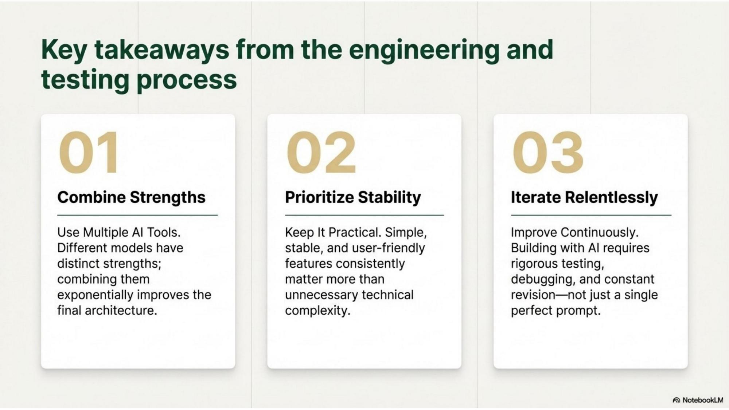

Slide 13
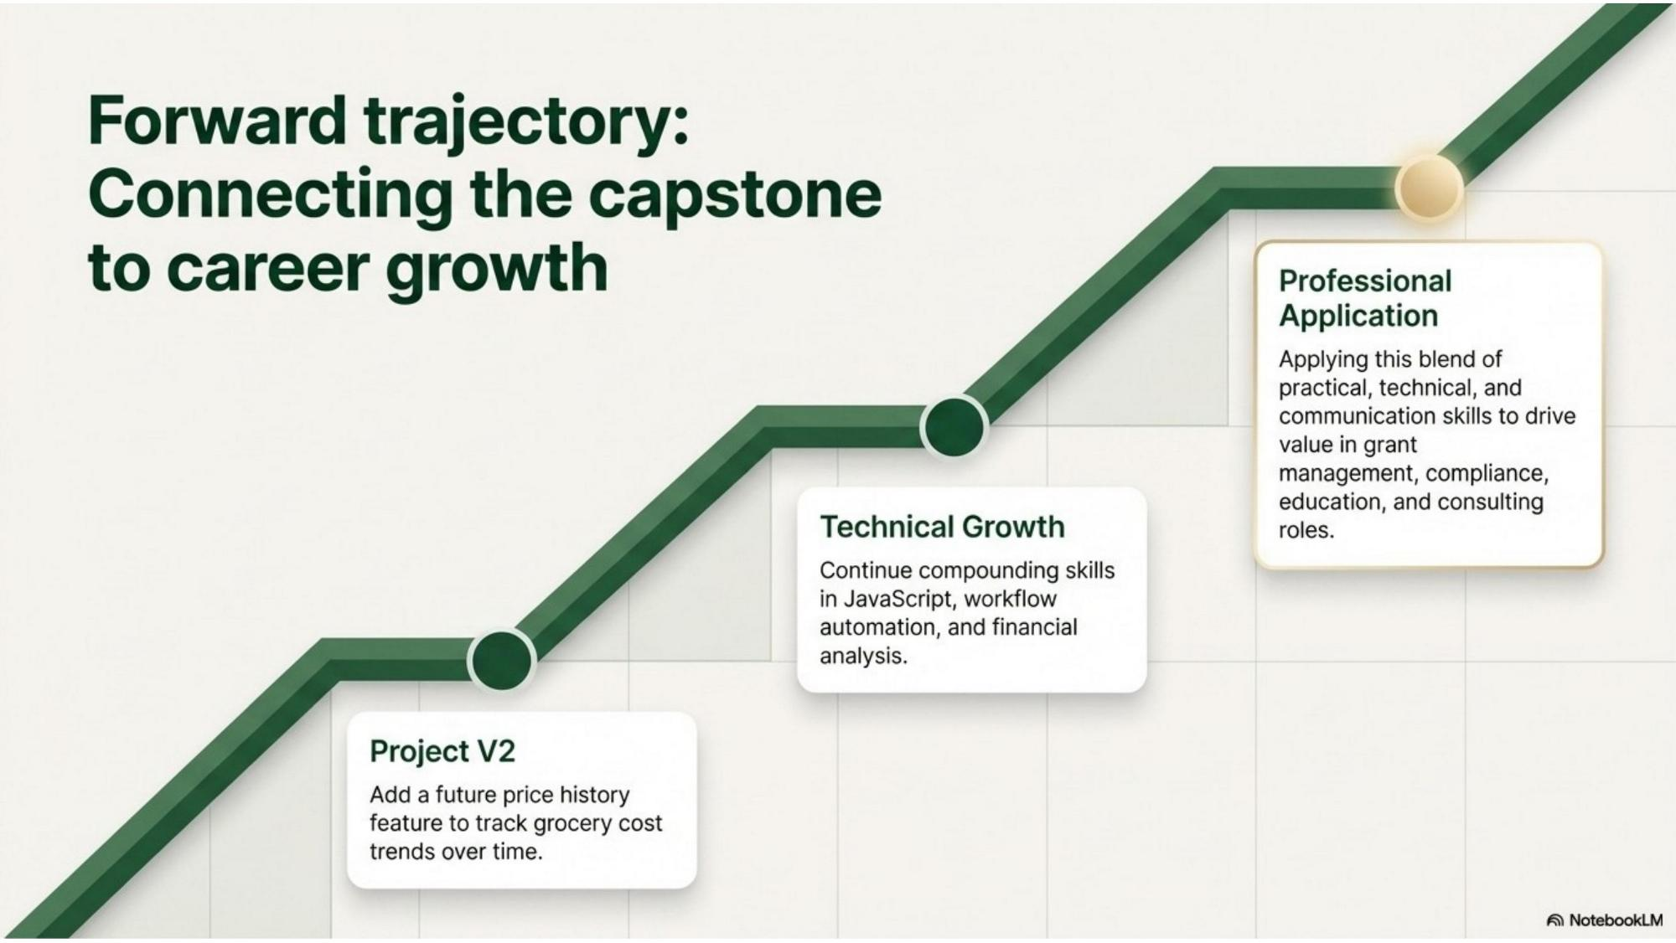

Slide 14



Thank You
From learning about AI — to using it with purpose.
Learned
Applied
Delivered

